Slide 1


Applications and Limitations of Positioning with Light
Chi Hin Lam (Tim)
林子軒
Benjamin Galuardi
www.tunalab.org

Slide 2
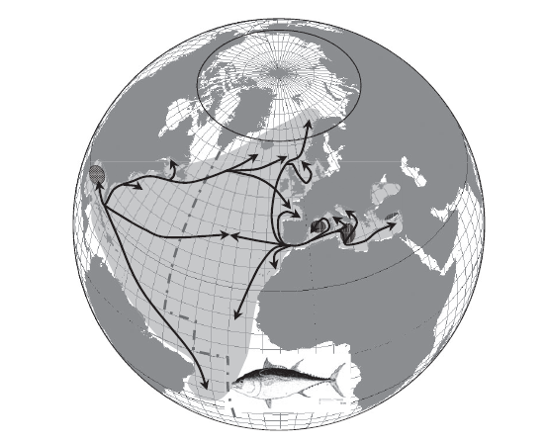
Why use light?
Non –airbreathing
Highly migratory
Figure from: Fromentin and Powers, 2006
Notes:
Non-air breathing marine animals, highly migratory, GPS will not work in salt water

Slide 3
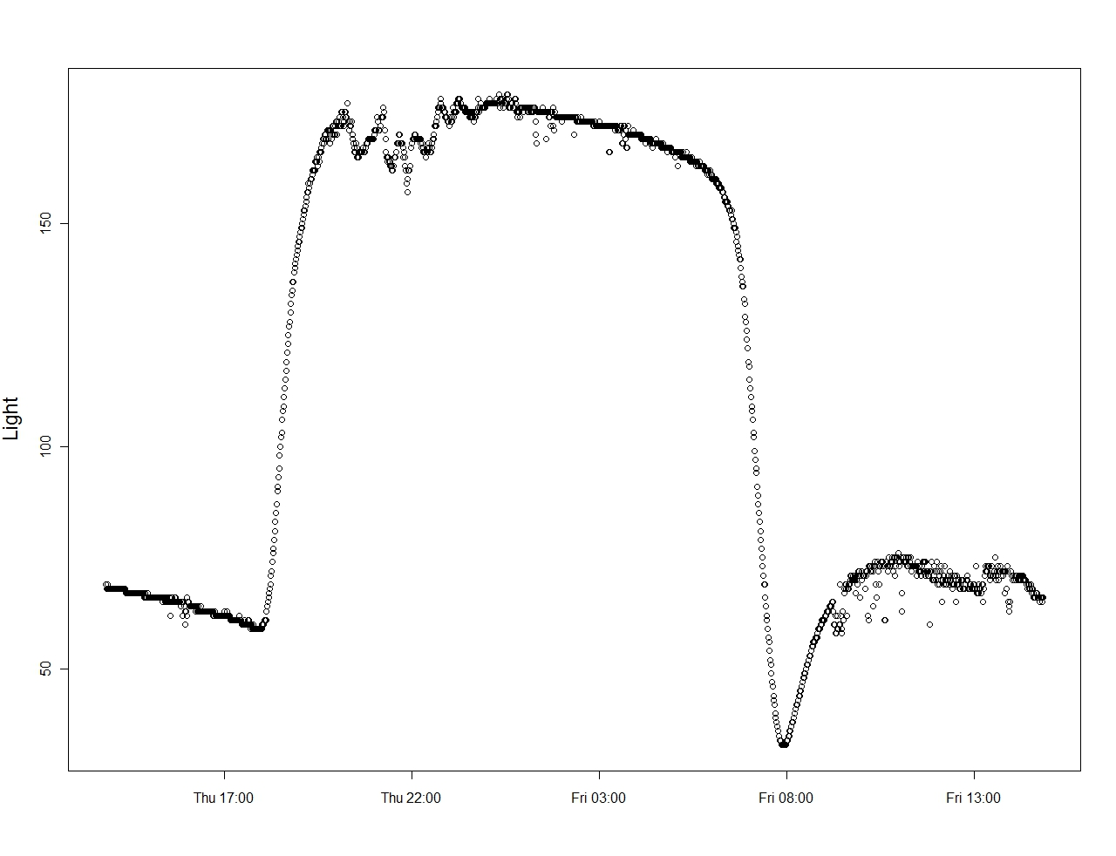
Sunrise
Local Noon
Sunset
Mooring Data off New Caledonia
Notes:
This is related to solar angle at time of sunrise and sunset.

Slide 4
Simplest geolocation strategy
a: solar altitude angle
δ: solar declination
φ: latitude
h: hour angle in degrees
T: time of sunrise or sunset in universal time
L: longitude (degree E of Greenwich)
E: equation of time in degrees
δ, E – depends on the day of year
Tag light level data
Times of sunrise and sunset calculated for a day
Time of local noon/ midnight
Day length
L = 180 - (T_{sunrise} + T_{sunset}) / 8 + E / 4
h _{at sunrise and sunset} = (T_{sunrise} - T_{sunset}) / 8
Longitude
Latitude
Notes:
The simplest geolocation strategy is the following
First, from the tag light level data, you estimate two times, one each for sunrise and sunset
From those, you can estimate local noon or midnight, that is the midpoint of the two times, and
Day length from the difference of the two times
Then you can come up with longitude and latitude using standard astronomical equations
The weakest part of this strategy is, you have to determine what light-level corresponds to a sunset
Additionally, when applying the standard astronomical equations, bias is introduced
because the tag or the fish is not really observing the sun, like what you would if you were to use a sextant
The equations can be applied this way. L is longitude and phi is latitude
The first equation shows you how longitude can be calculated, where E depends on the day of year
The second equation relates the hour angle with the sunrise and sunset times
Which can be substitute into the last equation to calculate latitude
Solar declination, delta depends only on the day of year, and
You calculate latitude by iteration for altitude a that takes a value between 3 to –5 degree with the last equation
Lastly, this last equation is a general one, which you can actually solve it once each for sunrise and sunset
And in that way, you are not necessarily limited to having only one latitude estimate per day
sin a = sin δ sin φ + cos δ cos h cos φ (a: solar altitude angle, δ: solar declination, φ: latitude, h: hour angle in degrees)
h = UT/4 – L – E (L: longitude, E: equation of time in degrees, UT: time of solar noon or midnight
in universal time as minute of day)
δ and E depend only on date of year
L is given when two observations of UT when the sun is at the same altitude and widely varying h (sunrise & sunset)
a = altitude/ elevation angle. 90 directly on top, 0 at horizon
zenith angle = 90 – a. 90 at horizon, 0 directly on top. Threshold: iterative between 87 and 95 deg (3 to –5 deg in solar altitude)

Slide 5
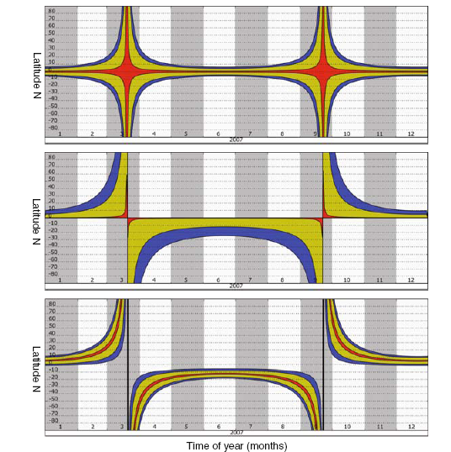
Error Structure
Error
Bias
Both
Off by:
1 min
30 min
60 min
Threshold method
Hill & Braun 2001;
Refs in Musyl et al. 2001
Dawn-Dusk Symmetry method
Hill in Musyl et al. 2001
Template fit
Ekstrom 2004, 2007
Royer & Lutcavage. 2009. Positioning Pelagic Fish from Sunrise and Sunset Times. In Tagging and Tracking of Marine Animals with Electronic Devices.
Notes:
Let’s revisit the weakest link, where you have to choose a light level to correspond to sunrise or sunset
One way to do so is referred as the threshold method
What you do is to find the brightest light, which is the dotted lines up top
and set the threshold value to be 1000 fold less than that, hence the solid lines
You can see the day length, that is the line segment in
between the sloping part of the light curves can be quite different,
depending on what you pick as the brightest part of the day
For example, if you get cloudy conditions during sunset, here on the left, your estimate will be off
And you don’t have to be off by too much to get the latitude estimates wrong
As shown here, the amount of latitude variation introduced when day length is off by 1 min to 60 min
Another way is a fitting a template to the light data, which is shown here
And has the ability to match the sloping part of the light curves better
An example of this approach is the dawn-dusk symmetry method by Hill and Braun in 2001
After that, this approach is fully developed by Phil Ekstrom and is generally referred as template-fit
Phil constructed an geophysical model and described how light reaches Earth’s surface thru the atmosphere
using the principles of radiative transfer in optics
This simplified model provides an idealized curve or template on the right
And fitting is done by moving the template up and down the y-axis (in log scale) to match a day’s worth of data
Fig. 3 Light data from April, 2000, Shaw Island, WA. Y axis ticks indicate factors of ten (decades) in irradiance. A total span of 10⁸:1 is shown. Dashed lines are example intensity references matched to the two partial days shown, solid lines three decades lower are corresponding thresholds. The lower threshold leads to an apparently longer day or shorter night.
Fig. 8. The heavy line is a template based on the curve of Fig.5 fit to the data of Fig. 2 (lighter line) over the range -5°<α<3°.
Fig. 4: Irradiance data normalized to the 92nd percentile, a measure of noon irradiance.
Fig. 6. Theoretical curves for blue irradiance during twilight. For elevation angles less than 3° and scattering stronger than α=0.03, the curves merge.

Slide 6
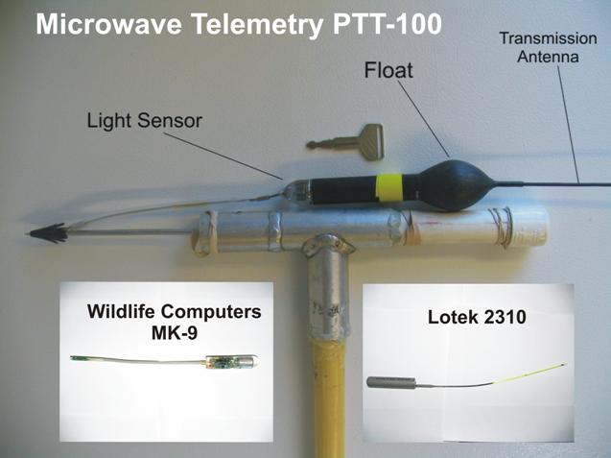
Implantable and Pop-up satellite archival tags (PSATs)

Slide 7
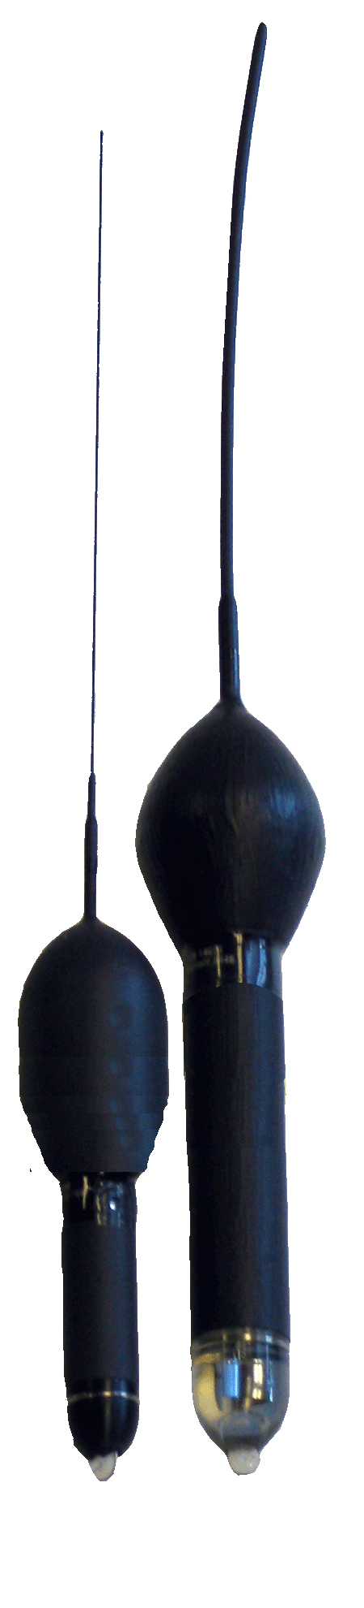
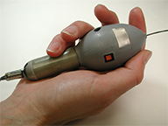
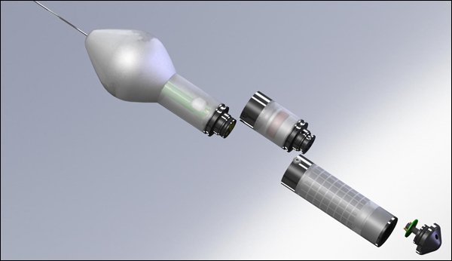
Wildlife Computers Mini-PAT
Microwave Telemetry X-Tag and Standard Pop-up Archival Tag
Desert Star Systems SeaTag-Mod
Notes:
Desert Star info:
Sensors 3-Axis Magnetometer Accelerometer Temperature Sensor Depth Sensor Light Sensing Sensor (through solar cell) Light Color Sensor ZigBee RF Module Additional Customized Sensors Energetic Pop-Up Release ARGOS Satellite Transmitter MicroSD card (up to 16GB storage space)
Powered Stored Solar Power Batteries (through connectors)

Slide 8
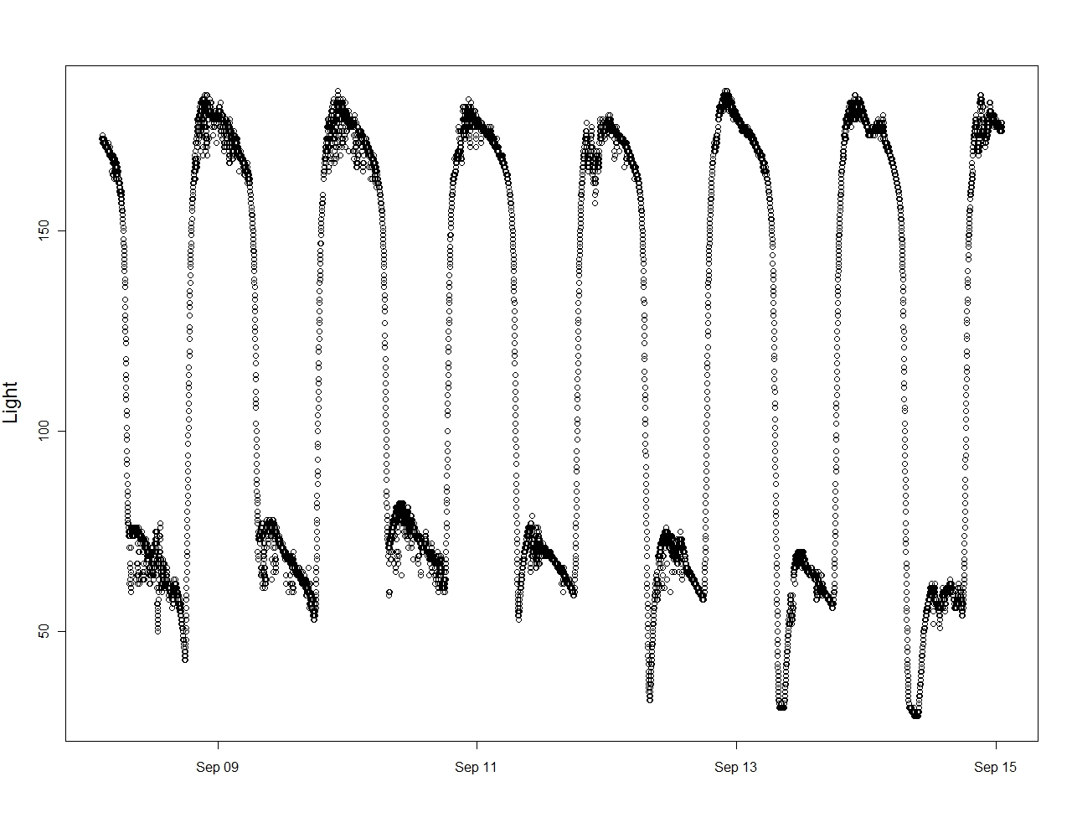
Mooring Data off New Caledonia
Notes:
Ask questions here: Moon and clouds for variable light levels

Slide 9
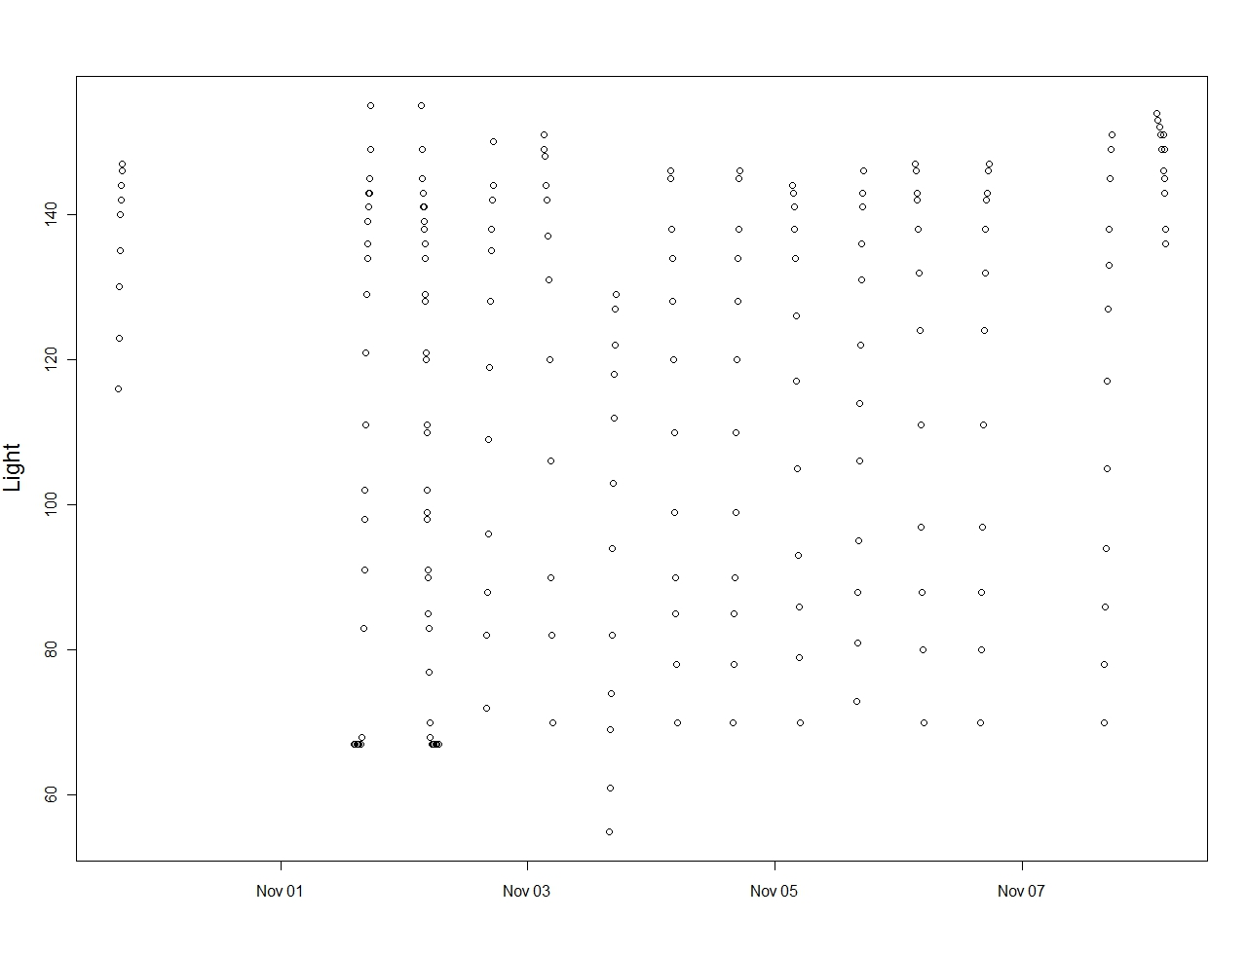
Drifter in the Pacific

Slide 10
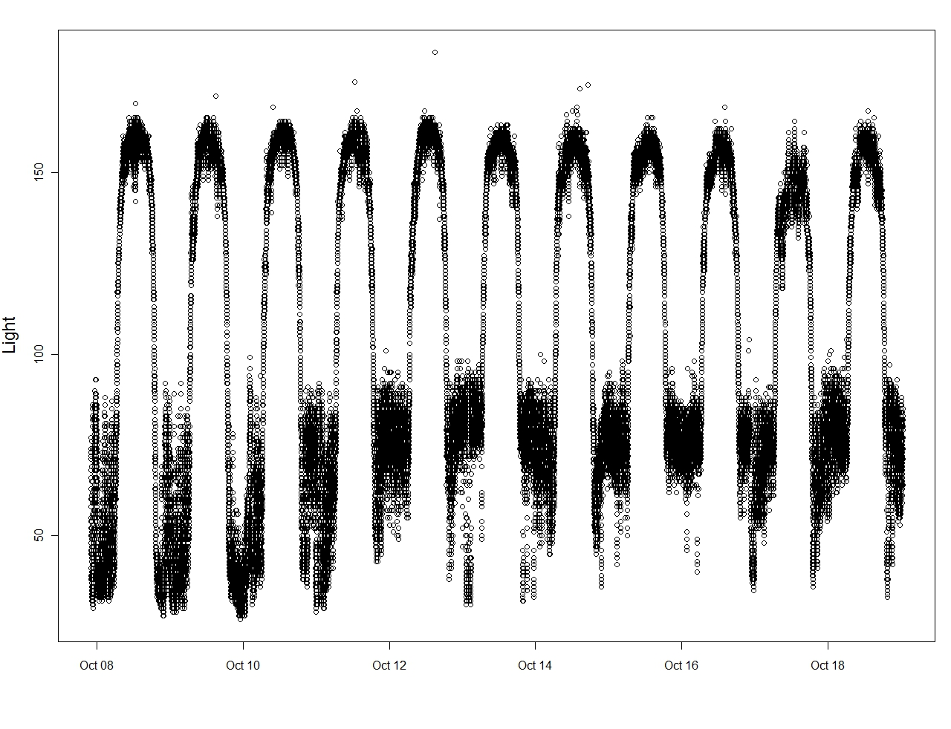
Bigeye tuna near the Azores

Slide 11
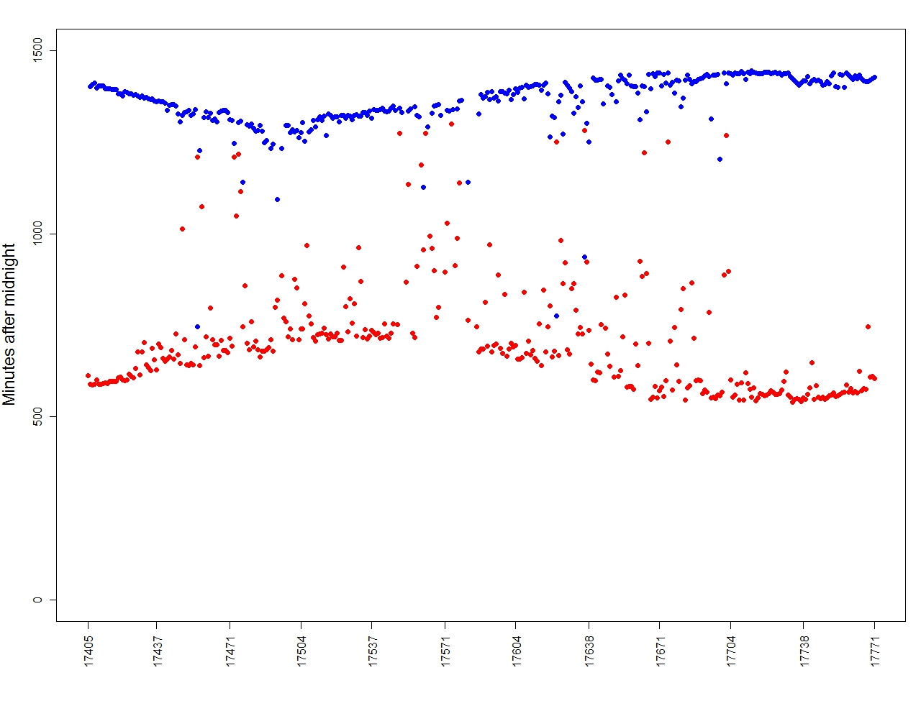
Microwave Telemetry Sunrise Sunset records

Slide 12
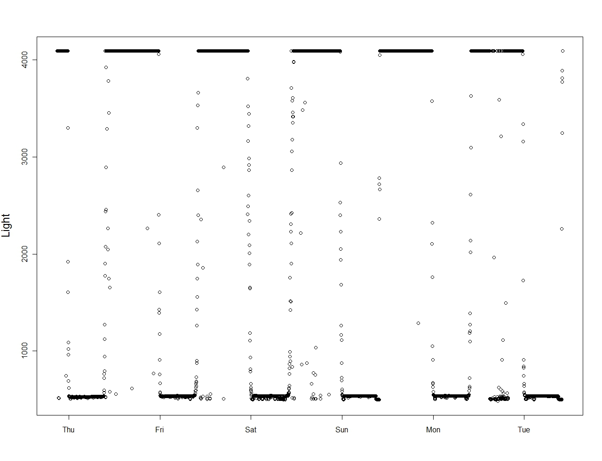
Bluefin tuna MTI X-tag (recovered)

Slide 13
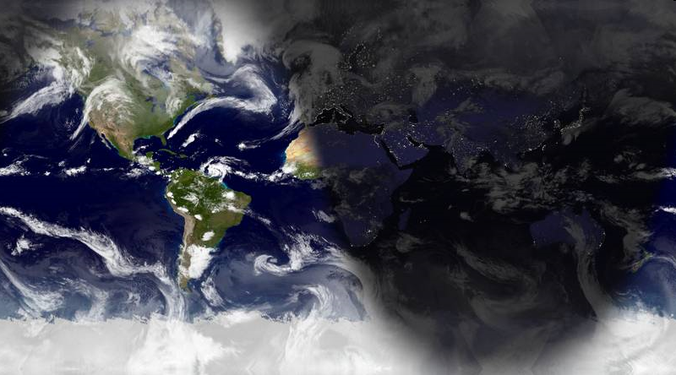
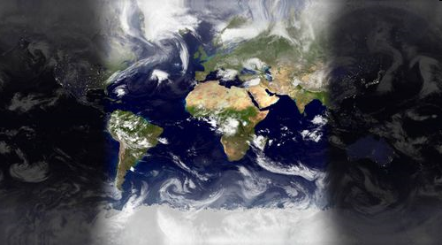
In a nutshell
Non - equinox
March equinox
Equinox (demo1)
High latitudes (demo2)
http://www.die.net/earth/
Notes:
To put it very graphically, we want to use sunlight to help us geo-locate.
And dark here is nighttime, bright area is daytime. This bright-dark edge is then sunset
This dark edge will move to your left, since the Earth rotates counter-clockwise
Because this edge is slanted, so along this edge, some places will get sunset earlier than others
Consider this same edge in March around the equinox, you can see it’s pretty much a straight line
Everywhere on this edge will have sunset at around the same time
And this makes latitude estimation very different.

Slide 14
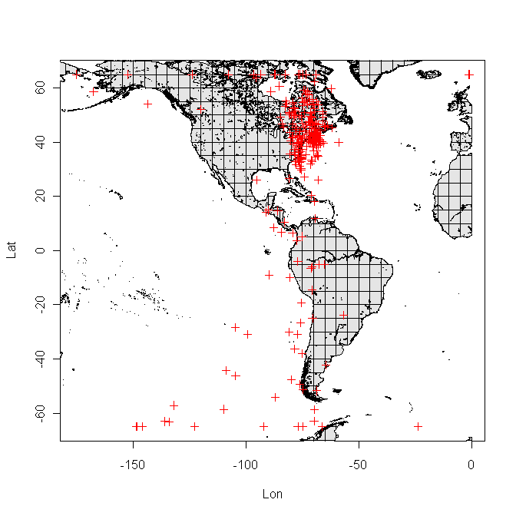

Geolocations from Light Data

Slide 15
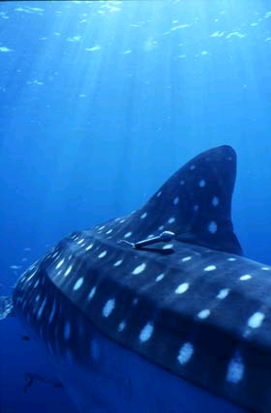
Recent Methods
Proliferation of statistical models to geolocation
State-space models
Nielsen & Sibert 2007
Pedersen et al. 2008
Royer & Lutcavage 2009
Sumner et al. 2009
Thygesen et al. 2009
Non state-space
Tremblay et al. 2010 (Forward particle filter)
Approaches to fitting a model
Maximum likelihood (linear)
Bayesian Monte Carlo (non-linear)
Error estimates/ confidence regions
Usually includes auxiliary data
Bathymetry
Coastline
Tides
Sea-surface temperature (SST)
Salinity
Geomagnetics**
Model for
incl. errors
Model for
incl. errors
Patterson et al. 2008. State-space models of individual animal movement. Trends in Ecol & Evol. 23(2) 87-94
Notes:
Our brief history doesn’t stop at 2006 of course, and in these few recent years,
We have a proliferation of statistical models for geolocation
State-space models are an attractive, and probably the most logical pick to do the job
The reason for why stems in how state-space models are set up
In essence, they are coupled models, one to describe the observations explicitly includes error
And another one to describe the process that cannot be directly measurement.
In our case, that is the movement from one position to another.
The remaining of my talk will feature these state-space models
But let me mention an alternative, a recent work by Tremblay et al.
Which argues state-space models take too much time to run and they have simpler and still perform well
Let me return to state-space models, once you have specified the model
The remaining part will be fitting the model, and there are two main approaches to do that
The simpler is the maximum likelihood estimation, which assumes linearity
Natural processes, as we know them, are rarely linear,
So a more sophisticated way is to handle the non-linear dynamics with Bayesian Monte Carlo simulations
This pretty much is what you need to know what is out there without going into the technical formulation
In any case, these approaches will provide error estimates and confidence regions around a track
They often incorporate auxiliary data from sea-surface temperature to coastal to further constrain the model

Slide 16
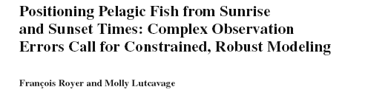
What’s hot?
Ideal for tags that only report sunrise, sunset times
Allow non-Gaussian error distributions
Heavy-Tailed via Gaussian mixtures
Gauss-Newton iterations
iterative filtering and smoothing
Hard constraints added with bathymetry/ coastline
Royer & Lutcavage. 2009. Positioning Pelagic Fish from Sunrise and Sunset Times. In Tagging and Tracking of Marine Animals with Electronic Devices.

Slide 17
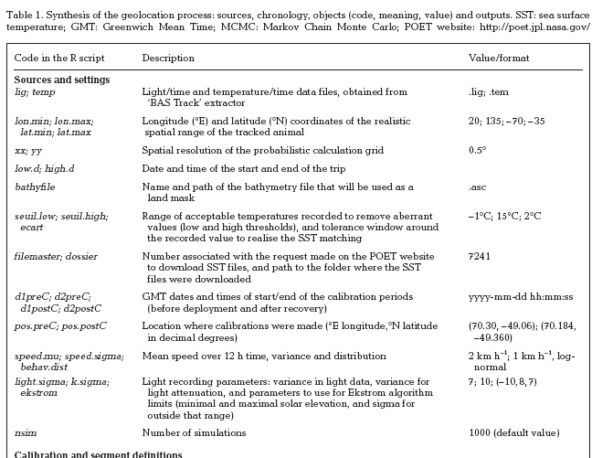
What’s hot?
Take light data
Apply template-fit
Incorporate coastline, SST
Flexible: Bayesian Estimation + Markov Chain Monte Carlo (MCMC)
Require some knowledge about the parameter values before any data is observed.
MCMC demands careful diagnosis of model convergence
R package: TripEstimation
Sumner et al. 2009. PLOS One Vol. 4(10) e7324
Thiebot & Pinaud. 2010. Repacking Sumner et al.

Slide 18
What’s hot?
Developed for depth recorders (no light)
Tidal (priority) and bathymetric matching
Explicitly incorporate behavior (low vs. high activity)
Non-Gaussian
Hidden Markov Models
The probability of fish resides in each grid cell at each time step
Matlab toolbox
Thygesen et al. 2009. In Tagging and Tracking of Marine Animals with Electronic Devices.
Pedersen et al. 2008. Can J Fish & Aqu Sci. 65:2367-2377

Slide 19
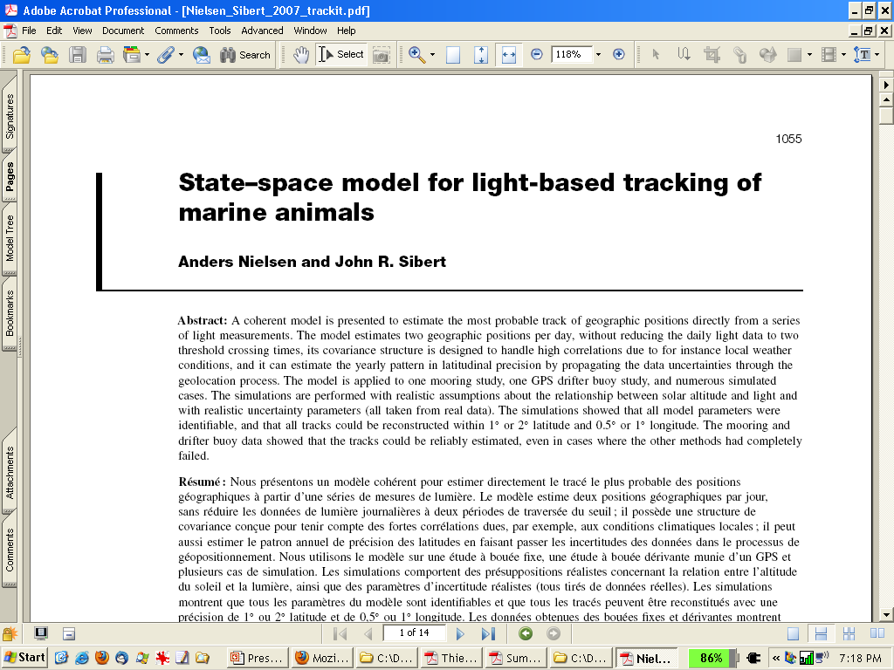
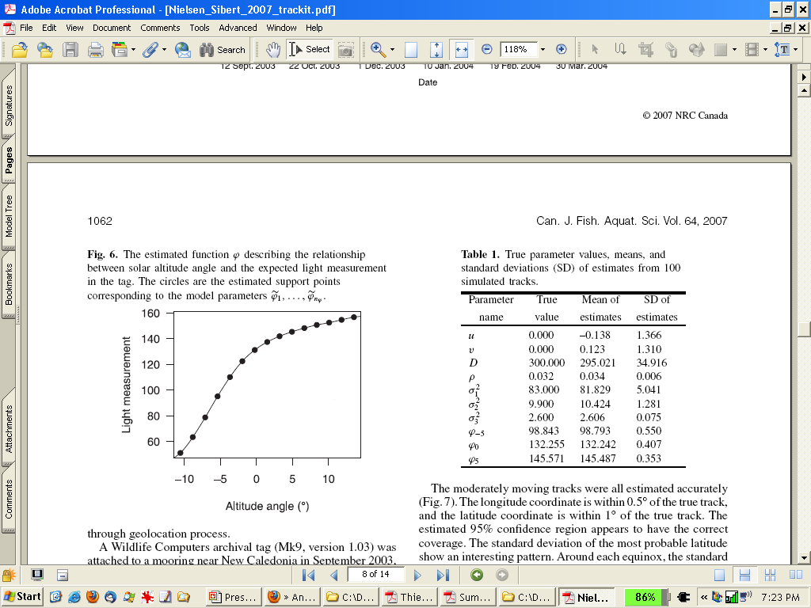
What’s hot?
Deal with light data from tags directly
Nielsen & Sibert. 2007. Can J Fish & Aqu Sci 64(8) 1055-1068
Notes:
Placeholder and lead in to next slides: Citation slide

Slide 20
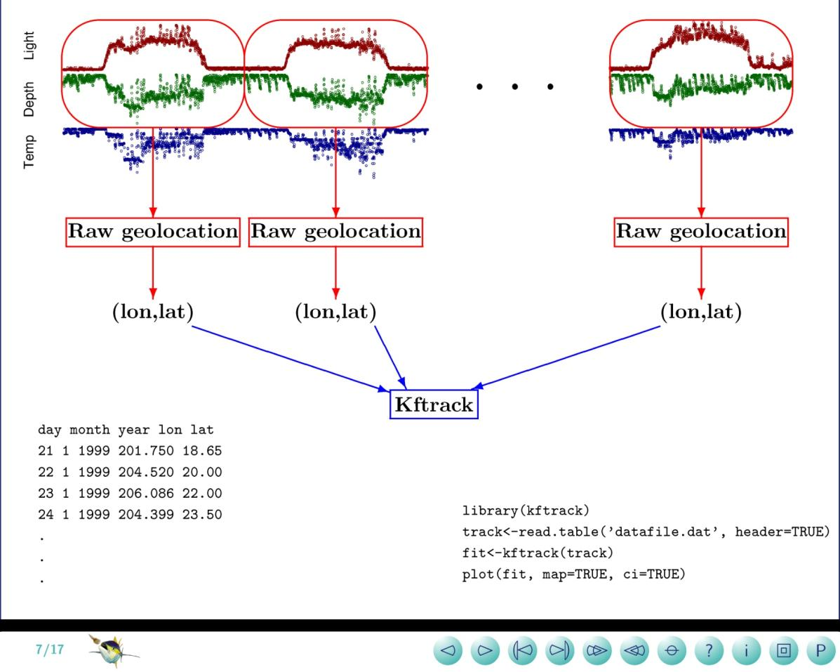
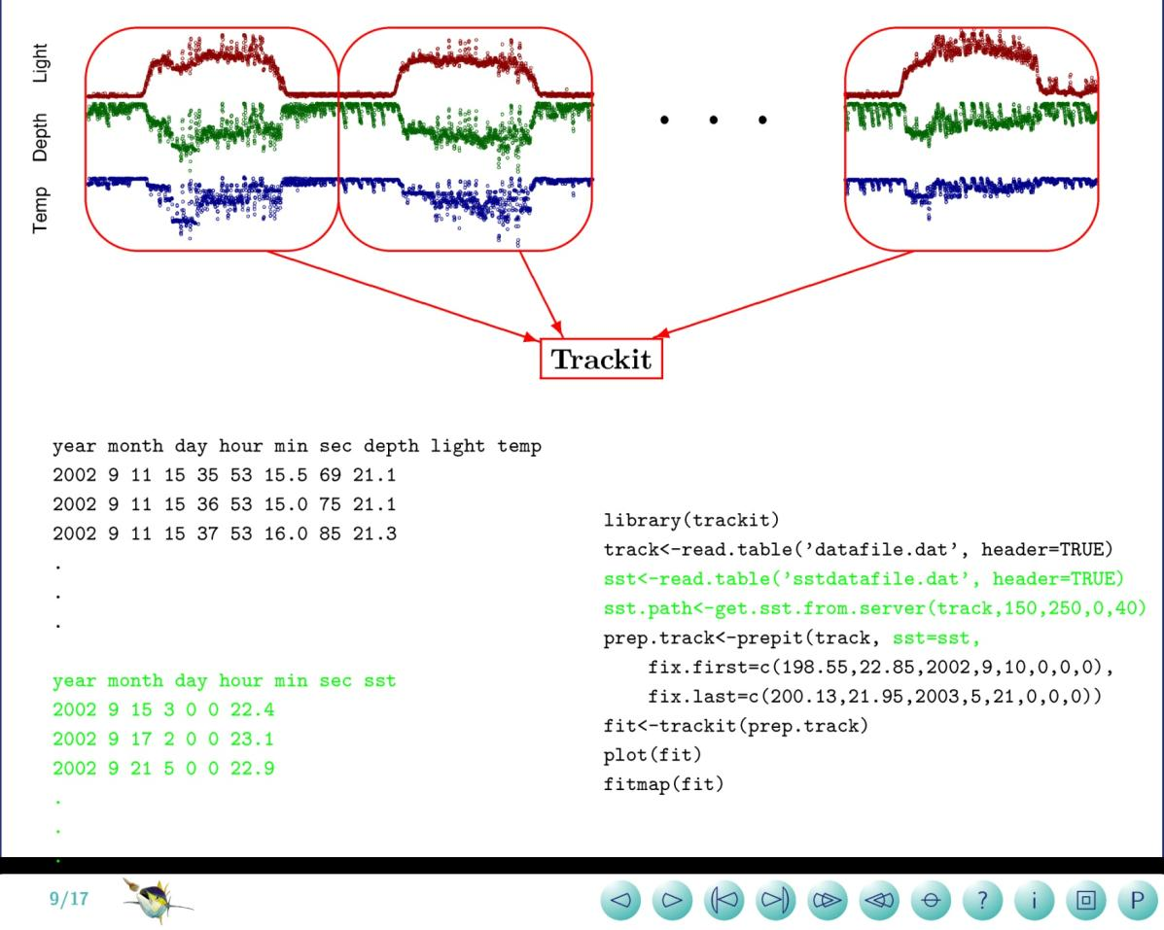
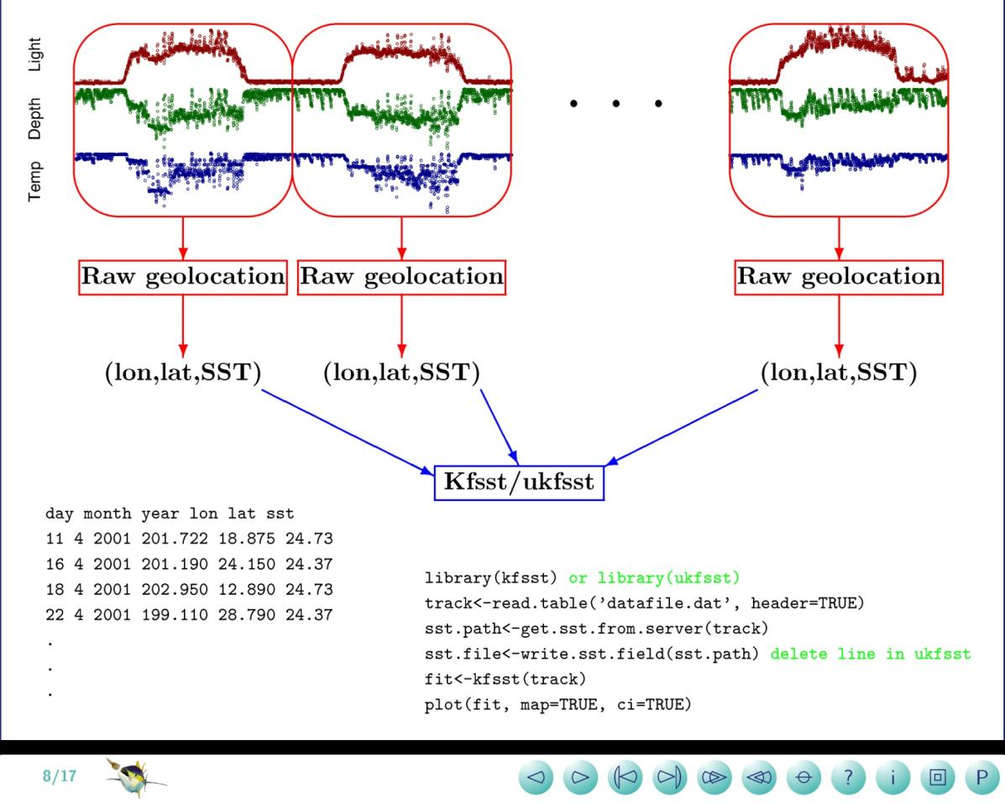
Goals of the “kf” models
To give us
a track of geographic positions
some ideas about the uncertainties
some quantitative movement parameters
Notes:
We have 3 goals with the KF models
We want to get
A track
Some ideas about the uncertainities
Some quantitative movement parameters for the tagged fish
Now I will show you schematically what the various KF models are:
First, the original, kftrack: using only raw geolocations, lat-lon pairs as inputs
Then it’s kfsst and ukfsst: which uses SST as well as raw geolocations as inputs
And lastly, trackit: which uses directly the raw data streams as inputs

Slide 21
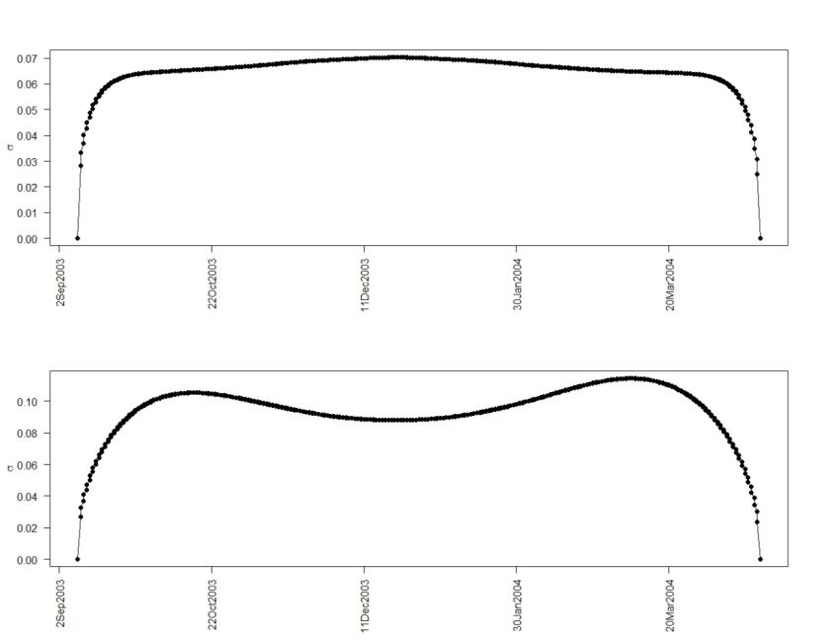
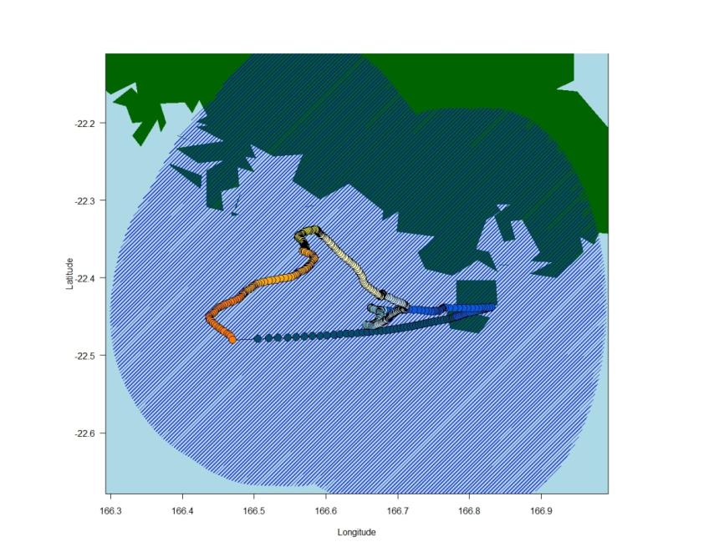
Trackit models using light curves
Mooring data again
Longitude error maximum: 0.7º
Latitude error maximum: 1.1º

Slide 22
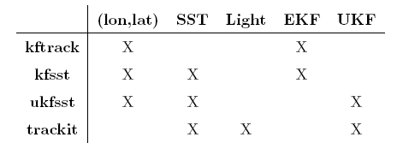
The “kf” family
Similarities
Underlying movement model
random walk with drift and diffusion
Observation model
predicts and describes observation error at any given position
Kalman filter (extended (EKF) or unscented (UKF) )
Maximum likelihood estimated model parameters
Most probable track
Weighted average of what is learned from the current position’s data and the entire track
Differences
Notes:
Let me point out the common threads among all KF models
First, they share the same underlying movement model that includes advection and diffusion
The observation model predicts and describes observation error at any given position
This turns out to be quite important, because as we all know, any instrument or device can make errors when you use it to measure something
Third, all models use the Kalman filter estimation
Fourth, all model parameters are maximum likelihood estimated, providing a means of model evaluation
Fifth, they provide the most probable track, which is an weighted average of what is learned from the current position’s data and the entire track.
In terms of the differences, the main difference is that the latest model, trackit utilizes the raw data streams directly.

Slide 23
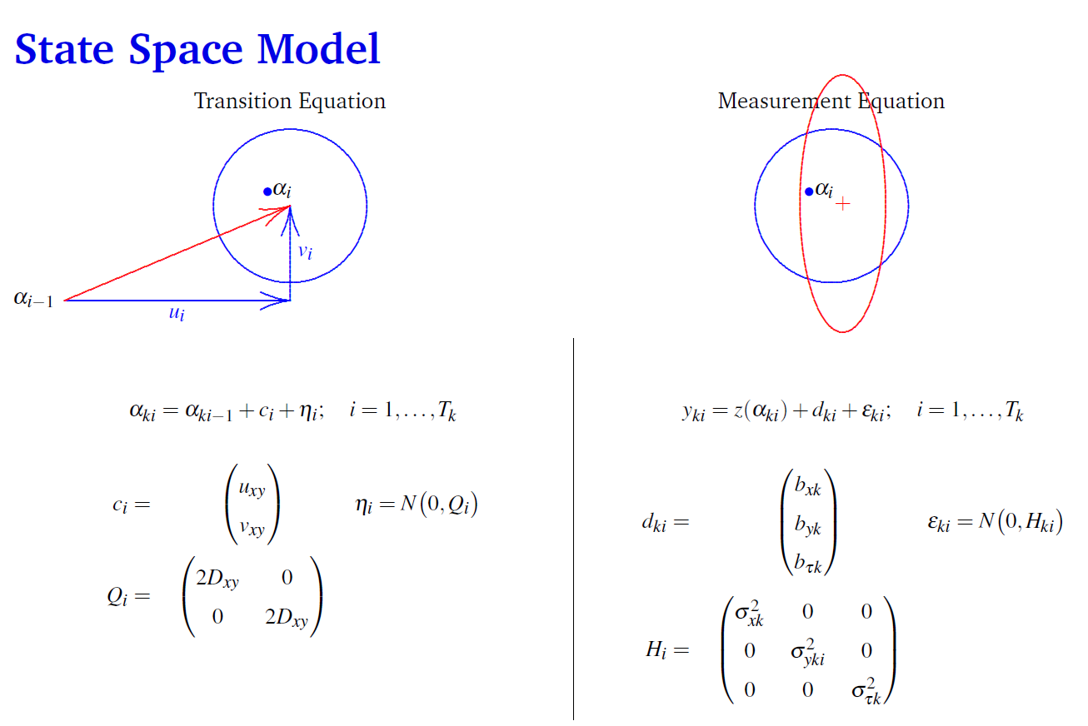
From Sibert PFRP presentation 2009

Slide 24
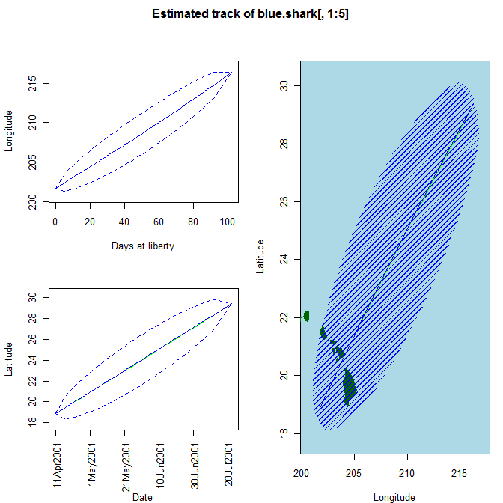
Blue Shark Scenario 1: No confidence in light based locations
day | month | year | Long | Lat | sst
11 | 4 | 2001 | 201.722 | 18.875 | 24.73
16 | 4 | 2001 | 201.19 | 24.15 | 24.37
18 | 4 | 2001 | 202.95 | 12.89 | 24.73
22 | 4 | 2001 | 199.11 | 28.79 | 24.37
24 | 4 | 2001 | 200.64 | 22.6 | 23.83
26 | 4 | 2001 | 197.81 | 19.2 | 23.39
28 | 4 | 2001 | 203.1 | 26.9 | 22.77
30 | 4 | 2001 | 203.29 | 28.52 | 22.95
2 | 5 | 2001 | 194.73 | 7.59 | 22.59
4 | 5 | 2001 | 198.68 | 22.95 | 23.12
Extended Kalman filter Implemented in kftrack software for R
http://www.soest.hawaii.edu/tag-data/tracking/kftrack/
kfit0 <- kftrack(blue.shark[,1:5], D.a = F, sx.init=1000, sy.init=1000, sy.a=F, sx.a =F, bx.a = F, by.a = F)
Notes:
This slide shows the linear nature of the model in the absence of any observations. Also shows the variance propagation according to the Diffusion part of the model

Slide 25
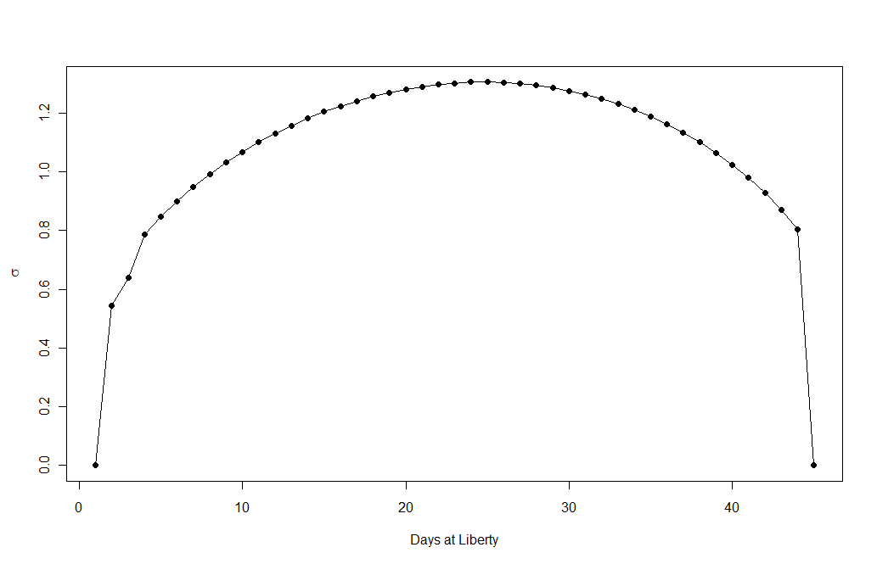
Parameter Estimates for this example
#R-KFtrack fit
#Thu Apr 15 11:11:15 2010
#Number of observations: 45
#Negative log likelihood: 691.326
#The convergence criteria was met
Estimates and Standard deviation
u | v | D | bx | by | sx | sy | a0 | b0
7.842879 | 6.160817 | 100 | 0 | 0 | 1000 | 1000 | 50 | -26.3788
1.3995 | 1.3987 | 0 | 0 | 0 | 0 | 0 | 0.000321 | 70.632

Slide 26
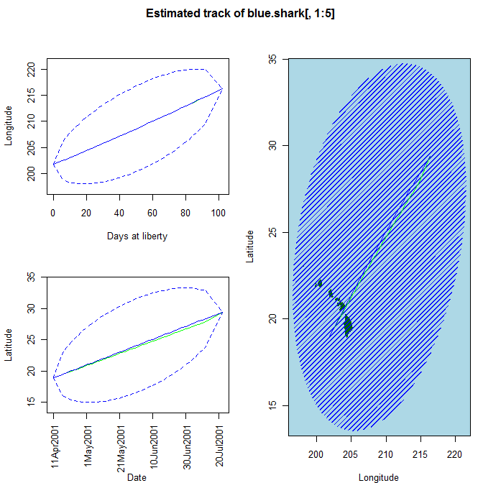
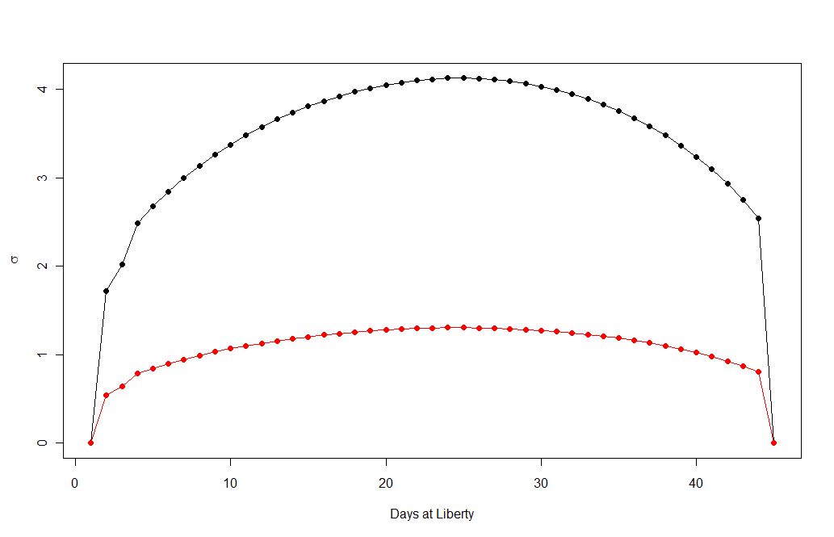
Blue Shark Scenario 2: Vary the initial parameters
kfit0 <- kftrack(blue.shark[,1:5], D.init = 1000, D.a = F, sx.init=1000, sy.init=10000, sy.a=F, sx.a =F, bx.a = F, by.a = F)
Notes:
This slide shows the linear nature of the model in the absence of any observations. Also shows the variance propagation according to the Diffusion part of the model

Slide 27
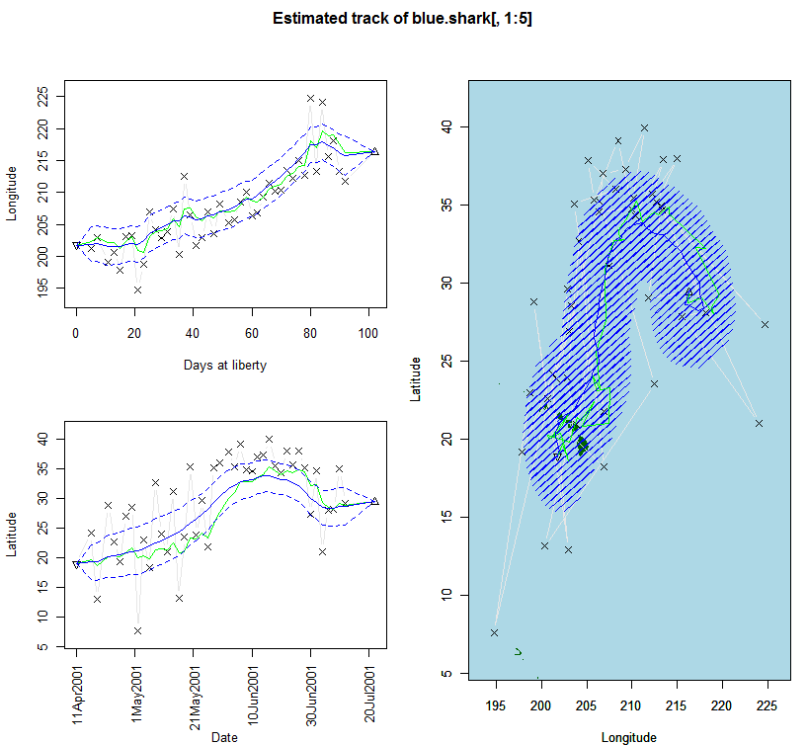
Blue Shark Scenario 3: Start with Latitude and longitudes
kfit0 <- kftrack(data, fix.first=T, fix.last=T, theta.a=c(u.a, v.a, D.a, bx.a, by.a, sx.a, sy.a, a0.a, b0.a, vscale.a), theta.init=c(u.init, v.init, D.init, bx.init, by.init, sx.init, sy.init, a0.init, b0.init, vscale.init), u.a=T, v.a=T, D.a=T, bx.a=T, by.a=T, sx.a=T, sy.a=T, a0.a=T, b0.a=T, vscale.a=T, u.init=0, v.init=0, D.init=100, bx.init=0, by.init=0, sx.init=.5, sy.init=1.5, a0.init=0.001, b0.init=0, vscale.init=1, var.struct="solstice", dev.pen=0.0, save.dir=NULL, admb.string=“”)

Slide 28
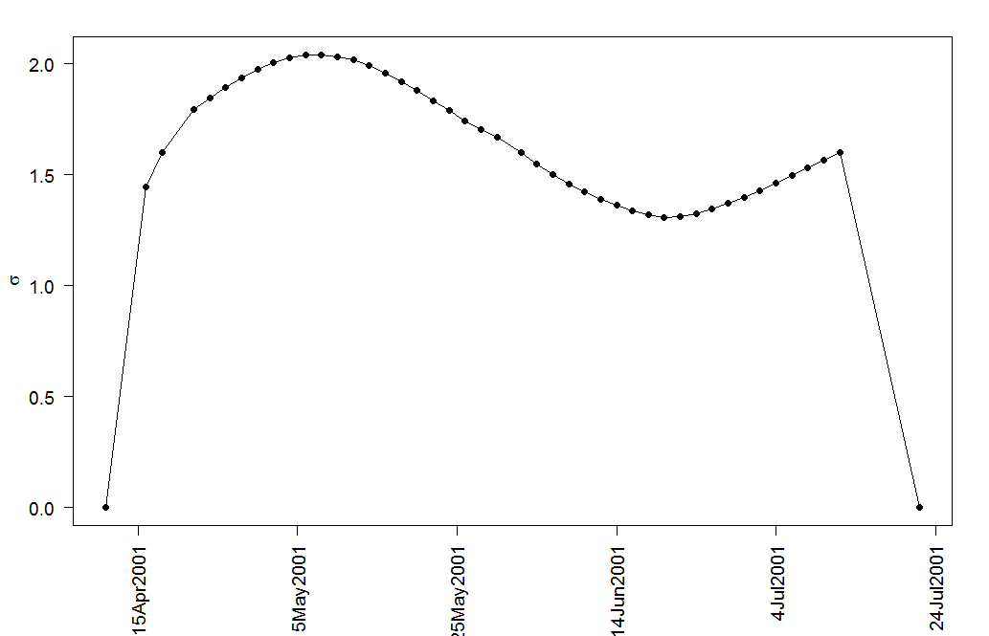
Parameter Estimates for this example
#R-KFtrack fit
#Thu Apr 15 11:10:19 2010
#Number of observations: 45
#Negative log likelihood: 259.941
#The convergence criteria was met
u | v | D | bx | by | sx | sy | a0 | b0
7.74596 | 6.094134 | 1141.276 | -0.84675 | 2.38231 | 3.238691 | 2.175821 | 0.068191 | 47.00363
4.7326 | 4.733 | 584.56 | 2.1036 | 2.2763 | 0.41011 | 0.60198 | 0.062291 | 5.8399
Notes:
Solstice variance effect

Slide 29
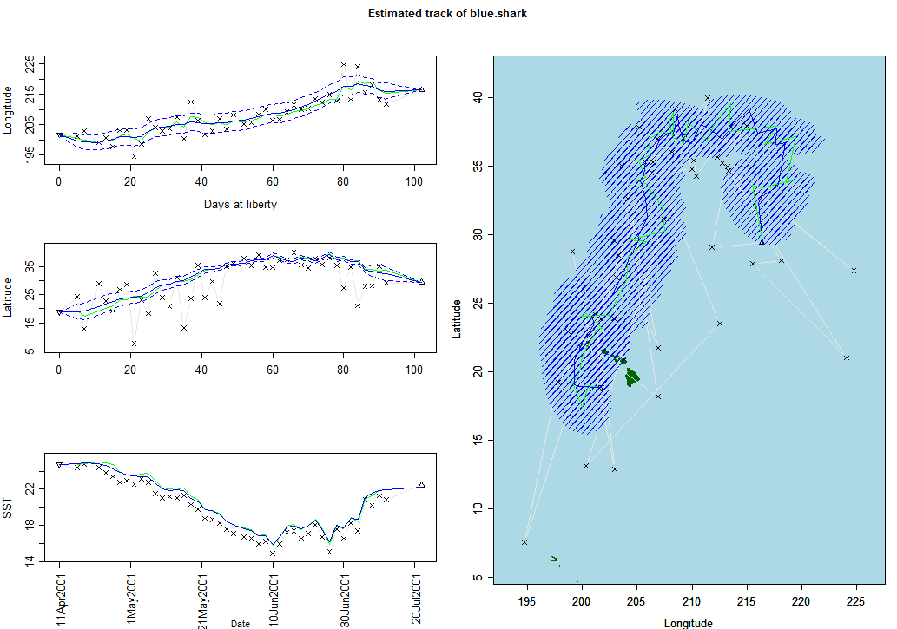
Blue Shark Scenario 4: UKFSST with lat, long and SST
ukfit <- kfsst(data = blue.shark, fix.first = T, fix.last = T, u.a = T, v.a = T, D.a = T, bx.a = F, by.a = F, bsst.a = T, sx.a = T, sy.a = T, ssst.a = T, a0.a = T, b0.a = T, r.a = FALSE, u.init = 0, v.init = 0, D.init = 100, bx.init = 0, by.init = 0, bsst.init = 0, sx.init = 0.1, sy.init = 1, ssst.init = 0.1, a0.init = 0.001, b0.init = 0, r.init = 200)

Slide 30
Parameter Estimates for ukfsst example
#R-KFtrack fit
#Thu Apr 15 14:00:47 2010
#Number of observations: 45
#Negative log likelihood: 325.074
#The convergence criteria was met
u | v | D | bx | by | bsst | sx | sy | ssst | radius | a0 | b0
-5.25742 | 7.323999 | 1231.295 | 0 | 0 | -0.75434 | 3.296683 | 2.658787 | 0.407174 | 200 | 0.084848 | 52.35625
4.8327 | 4.3202 | 349.31 | 0 | 0 | 0.24901 | 0.42093 | 0.72155 | 0.14663 | 0 | 0.07604 | 5.5784

Slide 31
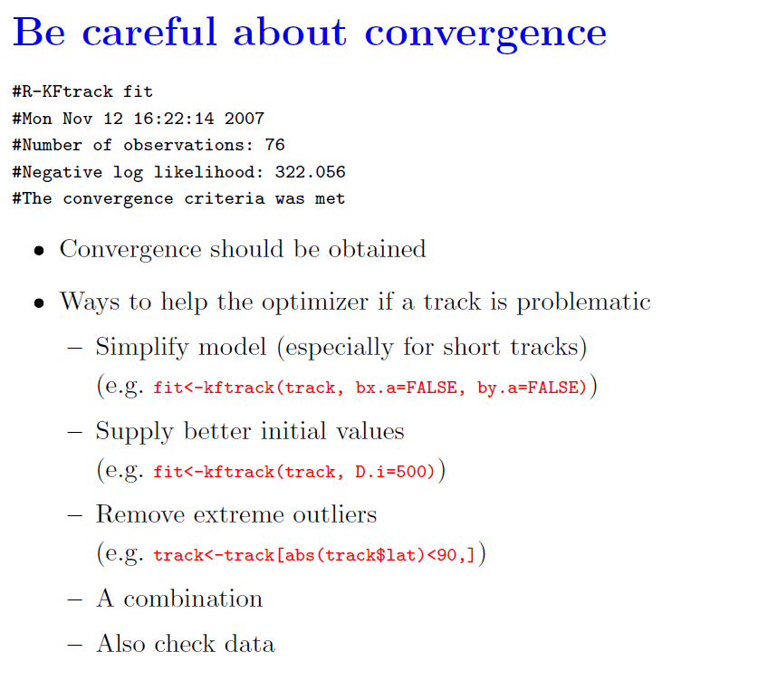
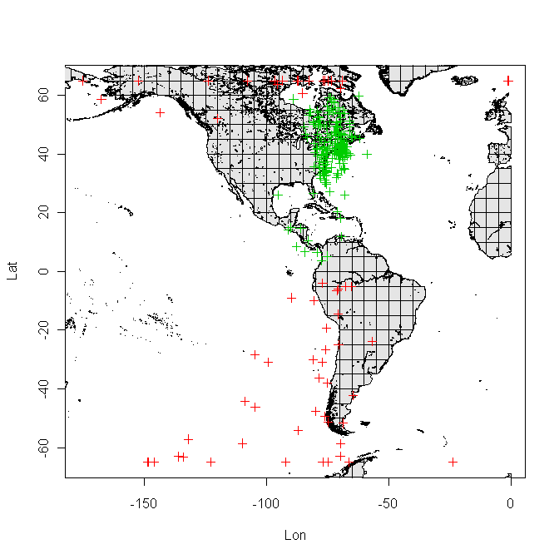
Nielsen and Sibert: PFRP PI meeting 2006

Slide 32
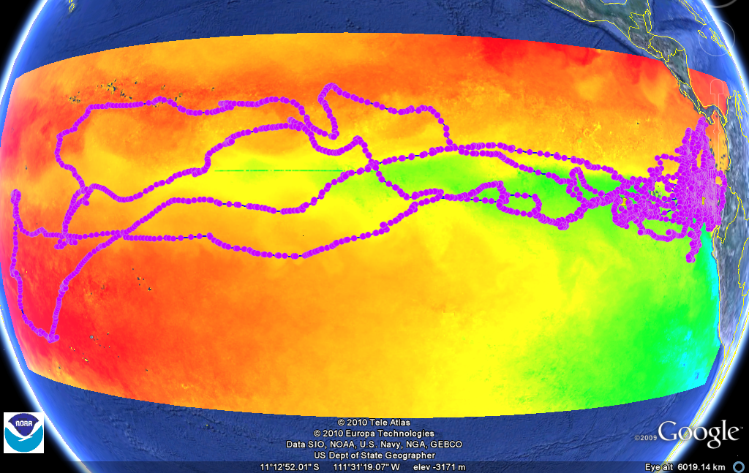
Longest track reconstructed by trackit+sst
Bigeye tuna (> 4 year; 2005 Apr – 2009 Jun)
Estimated length: 67 cm → 159 cm
Recaptured 1245 km from tagging location
Schaefer & Fuller. 2010. Vertical movements, behavior, and habitat of bigeye tuna in the equatorial eastern Pacifc Ocean, ascertained from archival tag data. Mar Bio 10.1007/s00227-010-1524-3
Notes:
SST – December 2005
Loops about 3 months moved with cold water

Slide 33
Accuracy (from ~10 validation studies)
A mixture of approaches (uncorrected, SST-matching, stat models)
Root-mean-square errors
Root mean square (Degree)
1 deg ~ 80 km in longitude/
110 km in latitude
Notes:
I did a first-cut comprehensive review of the literature that look at the accuracy of
various light-based geolocation approaches of the past 10 years
To save time, I lumped everything together, so that we can identify what are common to the many approaches
I want you to get 3 things out of this slide:
First, longitude is more reliably estimated, which is shown by the blue dots and fall with a 1-deg from a true position
Second, latitude, identified by the red points, are about 2-deg off from a true position,
Lastly, it is quite fair to say, under the best outcome, a light-based estimate will be
around ¼ (one-quarter) deg in longitude and latitude from the true position.
This number is almost like a measure of precision, and
can be an important idea to have when you evaluate your derived tracks

Slide 34
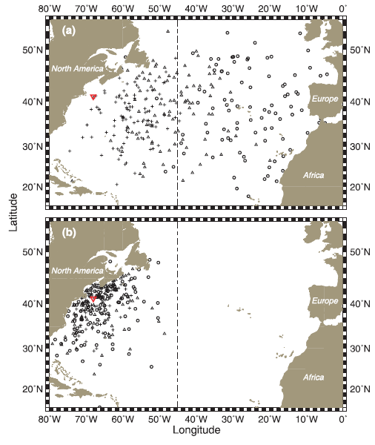
1999-2000
Use of individual information for population level inference
2002
Sibert, J.; Lutcavage, M.; Nielsen, A.; Brill, R. & Wilson, S.
Inter-annual variation in large-scale movement of Atlantic bluefin tuna (Thunnus thynnus)
determined from pop-up satellite archival tags
Can J. Fish. Aquat. Sci, 2006, 63, 2154-2166
Notes:
Potential applications to stock assessments begins with the Sibert 2006 study
Fig. 5. Simulated positions of 100 tagged fish after 30 days (+), 90 days (), and 1 year () at liberty. Distribution was computed
using u, v, and D estimated from the 1999 (a) and 2002 (b) deployments. The broken line at 45°W longitude is the line used to separate
bluefin tuna (Thunnus thynnus) stock management units. The inverted triangle () indicates release position.
Demonstrates potential to use individual information for population level inference

Slide 35
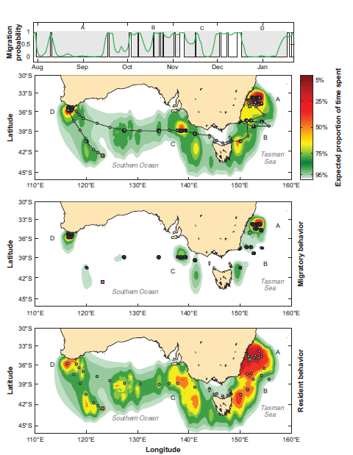
Residency distribution using HMM
Estimating animal behavior and residency from movement data
M. W. Pedersen, T. A. Patterson, U. H. Thygesen and H. Madsen
Oikos 120: 1281–1290, 2011
doi: 10.1111/j.1600-0706.2011.19044.x
Notes:
Abstract: We present a process-based approach to estimate residency and behavior from uncertain and temporally correlated movement data collected with electronic tags. The estimation problem is formulated as a hidden Markov model (HMM) on a spatial grid in continuous time, which allows straightforward implementation of barriers to movement. Using the grid to explicitly resolve space, location estimation can be supplemented by or based entirely on environmental data (e.g. temperature, daylight). The HMM method can therefore analyze any type of electronic tag data. The HMM computes the joint posterior probability distribution of location and behavior at each point in time. With this, the behavioral state of the animal can be associated to regions in space, thus revealing migration corridors and residence areas. We demonstrate the inferential potential of the method by analyzing satellite-linked archival tag data from a southern bluefin tuna Thunnus maccoyii where longitudinal coordinates inferred from daylight are supplemented by latitudinal information in recorded sea surface temperatures.
Figure 3. Top panel: the black line is the most probable behavior switching sequence and the green line is smoothed probability of the migratory behavioral state. Shaded areas relate the behavior switching to the corresponding spatial regions specified in the distribution plots below. Bottom panels: most probable trajectory of the switching diffusion–advection model for the southern bluefin tuna from its release 29 July 2003 to pop-up 22 January 2004. Shaded circles indicate migrating behavior, blue circles indicate resident behavior, green circle is release location and orange square is pop-up location. Underlaid are residency distributions (top: both behaviors, middle: resident, bottom: migratory) showing the expected proportion of time spent by the SBT within the contoured regions. Note that the trajectory deviates from the residency distribution at the migration from the Tasman Sea to the Southern Ocean (details in Methods and Discussion sections). Matlab’s contourf function was used to plot the matrices containing the residency distributions.

Slide 36
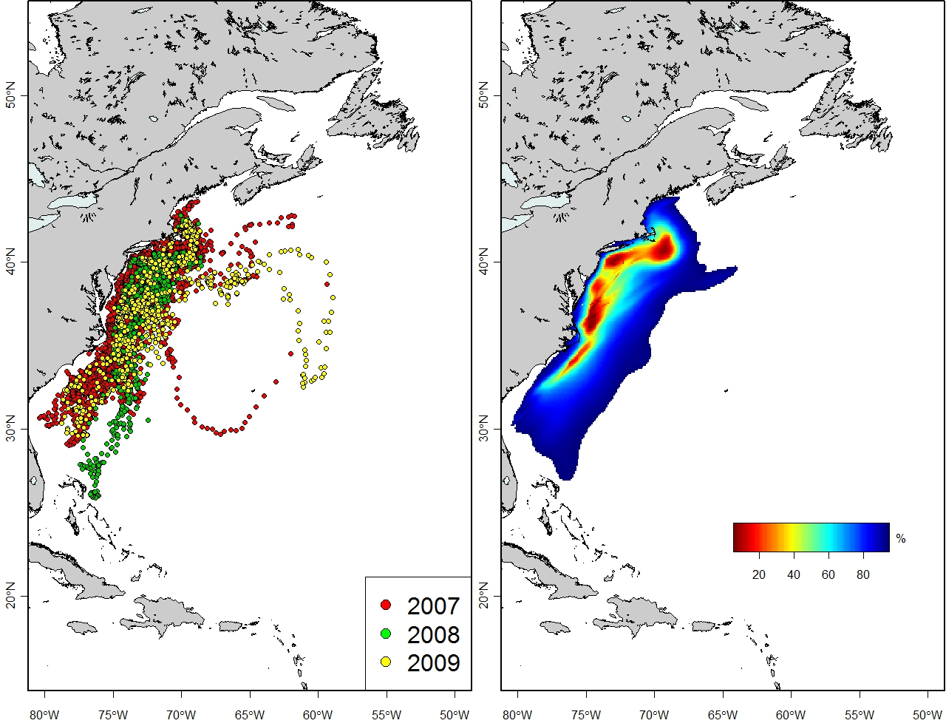
Galuardi et al. submitted to PlosOne
Notes:
Utilization distribution using uncertainty in UKF estimates.
Can be broken down seasonally
Can possibly be used as correction factors to other observations in catch, vulnerability and conventional tag releases
Older fish show more dispersed movements over greater distances than younger fish—but our sample of older fish is greatly compromised!
Core use areas correspond both in location and range with the rec fishery

Slide 37
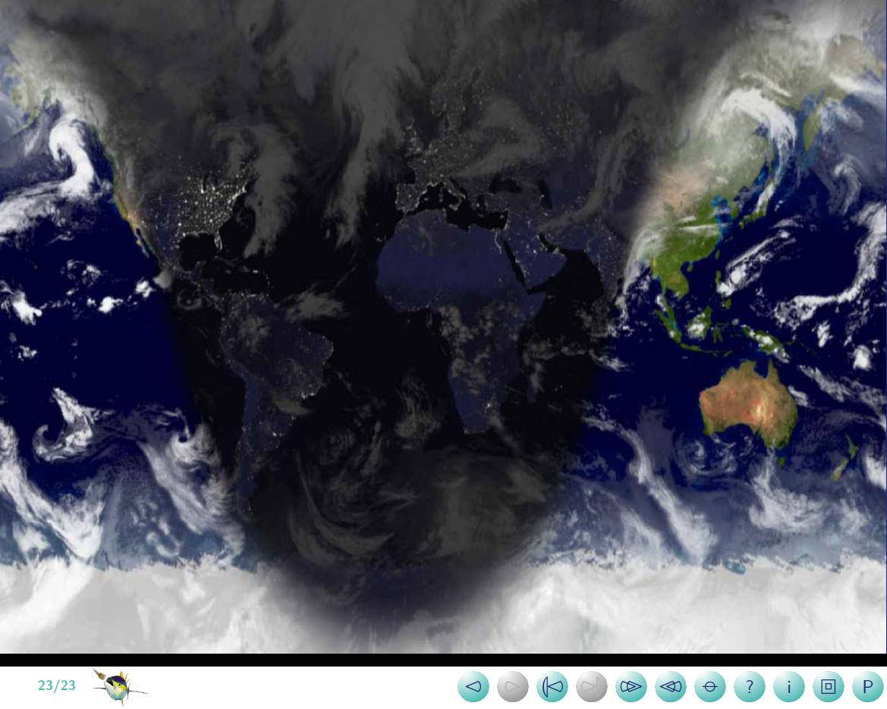

www.tunalab.org
Notes:
Put Hodgkins Cove picture!

Slide 38
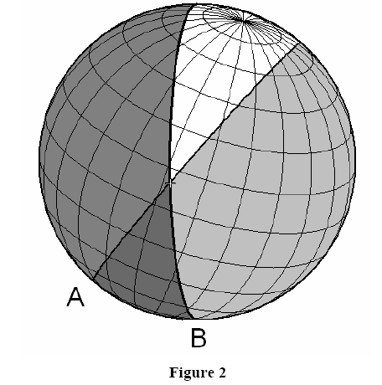
Concept – dawn dusk curves
Hill (1994)
Roger Hill. Wildlife Computers
Wildlife Computers-GPE Suite Manual
Notes:
Let put those ideas back together again
We project that same sunset edge, on the Earth, as A
About 12 hours later, it will be sunrise, and the sunrise edge is B
Let’s assume there is no change in position between sunrise and sunset
The intersection of these two curves will give us the position, as represented by the cross.
We talked about how equinoxes are tricky, very much because the two curves can’t intersect.
We actually can get the curves to intersect if we change to view at a range of altitude angles
More specifically from -3 to 5°.
But it’s definitely far from optimal, because you usually have two intersection points
One for the Northern Hemisphere and one for the South. And it only works out for higher latitudes

Slide 39
Correction techniques
Criteria
based
SST/ Longitude Matching
Speed filter
Extended Kalman Filter
Ensemble Kalman Filter
Kalman Filter
Sea surface Temperature
State Space Methods
Unscented Kalman Filter
Particle filter
Bathymetry
Tides
Hidden Markov Model
Geomagnetics**
Notes:
Auxiliary information

Slide 40
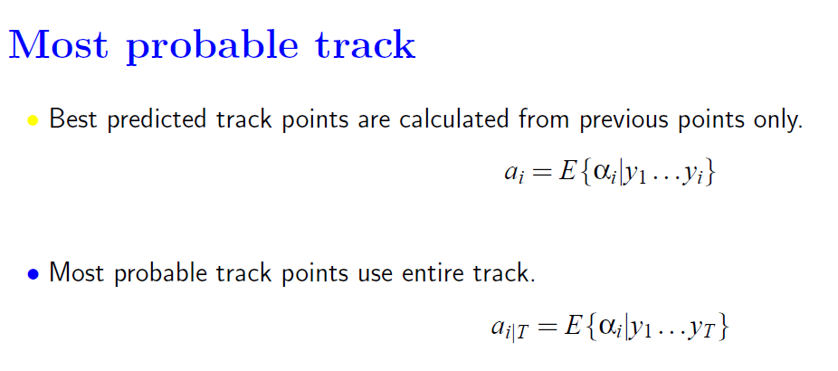
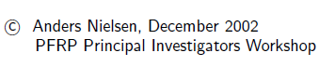
Notes:
Single backwards sweep which is essentially uses the KF along the predicted track in reverse order.

Slide 41
Potential applications for stock assesments
Parameter estimation from electronic tagged fish

Slide 42
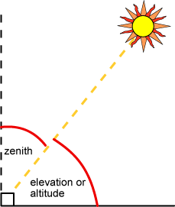
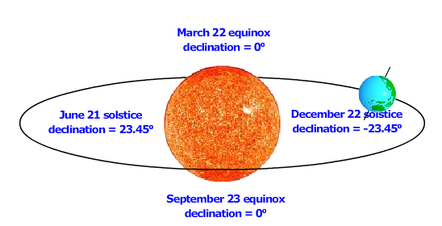
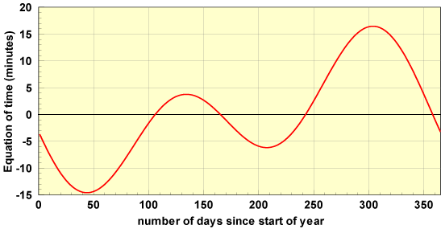
Basic Terms
Solar (altitude, elevation) angle
Angular height of the sun in the sky measured from the horizontal
Zenith angle: 90° - solar angle
Directly overhead: 0°
Horizon: 90°
Hour angle: time of day expressed in degrees
Solar declination
Varies seasonally due to the tilt of the Earth on its axis of rotation and the rotation of the Earth around the sun
Between -23.45° to 23.45°
Equation of time
Corrects for the eccentricity of the Earth's orbit and the Earth's axial tilt.
http://pvcdrom.pveducation.org/SUNLIGHT/ELEV.HTM
Notes:
Now let me give you the definitions of a few terms you will frequently come across when you read the literature on light-based geolocation
First, solar altitude or elevation angle. That is simply how high the sun is up. We describe that as an angle from the horizon
The zenith angle is just another way to say to the same thing.
It is just that we measure from directly overhead instead of the horizon
And this picture tells it all
Then, solar declination – it’s the solar rays from the sun usually hit the surface of our Earth at an angle.
This is because the Earth is tilted at 23.45 degrees from the vertical. This same gives us the 4 seasons,
As summarized by this picture. As you can tell, solar declination is related to the time of the year.
The last term, Equation of time is also related
The Earth orbits the Sun at a slightly different speed throughout the year.
An empirical equation describes that, and is plotted here as a function of the time of the year.
No website is better than this site here in describing the sun. And this site is designed for solar panels or PVC cells.
So look it up if you are interesting in harvesting the sun yourself

Slide 43
Light-based geolocation
Smith and Goodman 1986
Wilson et al. 1992
Hill 1994
Hill & Braun 2001
Ekstrom 2004
Accuracy
Gunn et al. 1994
Welch & Eveson 1999
Musyl et al. 2001
Tag development
Archival: 2nd generation
PSAT: Block et al. 1998
Data storage tags (no light)
Improve latitude estimates
Logic filter: Schaefer & Fuller, 2002
Speed filter etc.
Improve latitude estimates with satellite sea surface temperature (SST)
Delong et al. 1992
Block et al. 2001
Inagake et al. 2001
Kitagawa et al. 2002
Itoh et al. 2003
Sims et al. 2003
Shaffer et al. 2005
Bonfil et al. 2005
Visualization & analysis
Major operations: e.g. TOPP, NOAA, CSIRO
Coyne & Godley 2005 (Satellite Tracking & Analysis Tool)
Chao et al. ASLO 2006
Environmental Analysis System (EASy)
Criteria-based search routine
Beck et al. 2002
Teo et al. 2004
Domeier et al. 2005 (PSAT Tracker)
State-space models
Sibert et al. 2003 (Kftrack)
Jonsen et al. 2003, 2005 (Meta-analytical)
Royer et al. 2005 (Particle filters)
Nielsen et al., 2006 (Kfsst)
1990
1998
2000
2001
2002
2003
2004
2005
2006
Notes:
Here’s a brief history of electronic tags and geolocation
Archival tags and the pop-up versions were available and became very popular in the late 90s.
Since it is not feasible to use radio waves to communicate when a tag is submerged underwater
Positioning with light was first conceptualized in 1986 by Smith and Goodman.
A couple of bright guys including Rory Wilson, Roger Hill and Phil Ekstrom further formulated the light-based geolocation methods
Latitude has always presented extra challenges in estimating correctly.
Early work to evaluate the accuracy by Musyl et al. 2001 reports as much as 40 degree error in latitude estimates
Different approaches are taken to narrow down the latitude estimates
And namely, sea-surface temperature matching has become a major approach in improving latitude estimates

